Slide 1
MatLab/Octave
Project
Hieu Do

Slide 2
Vectors1
For this entire project I used Octave
I used https://www.tutorialspoint.com/matlab/matlab_vectors.htm for this tutorial
The first things that I learned was vectors which are matlab/octave version of 1 dimensional arrays
First I learned how to make a row of numbers with this via r = [7 8 9 10 11] to get
r =
7 8 9 10 11

Slide 3
Vectors2
For a column of arrays c = [7; 8; 9; 10; 11]
You have to add an ; after each element
Also to reference a specific element use x(i) also conveniently vectors index starts at 1 unlike java for c(3) I would get 9
You can also use x(:) to get every element in the vector
Matlab/Octave also lets you reference/get a range of elements for instance
rv = [1 2 3 4 5 6 7 8 9];
sub_rv = rv(3:7)
sub_rv =
3 4 5 6 7

Slide 4
Matrix1
Since vectors are just 1 dimensional arrays in matlab/octave I figure that I should learned what other arrays are available so I did this tutorial next
https://www.tutorialspoint.com/matlab/matlab_matrics.htm
a = [ 1 2 3 4 5; 2 3 4 5 6; 3 4 5 6 7; 4 5 6 7 8]
The above code creates a 4 by 5 matrix where each row is separated by a semicolon that tells the system to go to the next row resulting in
a =
1 2 3 4 5
2 3 4 5 6
3 4 5 6 7
4 5 6 7 8

Slide 5
Matrix2
In order to reference a specific element in a matrix we can use m(x,y)
So for the previous matrix we use a(2,5)
To get = 6
You can also call an entire column like this v = a(:,4)
v =
4
5
6
7
For rows you would do v = a(4,:)

Slide 6
Matrix3
You can also call specific section of a matrix like this a(:, 2:3)
To get this ans =
2 3
3 4
4 5
5 6
You can also delete entire column or rows with this
a( 4 , : ) = [] For rows specifically the 4th row
a(: , 5)=[] = For columns specifically in this case the 5th column

Slide 7
Loops1
https://www.tutorialspoint.com/matlab/matlab_while_loop.htm
In a while loop the situation is pretty similar to that of java except in order to properly close the while loop you need an end command
while <expression>
<statements>
end
It the model they showed me and this was the example
a = 10;
% while loop execution
while( a < 20 )
fprintf('value of a: %d\n', a);
a = a + 1;
end

Slide 8
Loops2
In a for loop it a lot different from java
for a = 10:20
fprintf('value of a: %d\n', a);
end
Where 10 is the start of the loop and 20 is the end of the loop and the program itself just prints the numbers from 10 to 20
You can also decrease a loop like this for a = 1.0: -0.1: 0.0
disp(a)
end
1.0 is the start then it minus 0.1 every time until it reach 0

Slide 9
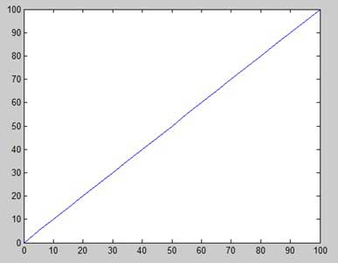
Plots
Next I decided to learn how to plot the graph since that is the end goal of this project so I used this tutorial
https://www.tutorialspoint.com/matlab/matlab_plotting.htm
First we have to create an x and a y to graph and the example they showed was
x = [0:5:100];
y = x;
Then we call the plot command to graph it
plot(x, y)

Slide 10
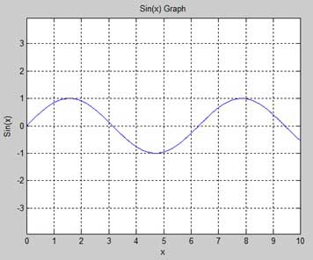
Plot2
They also showed how to add labels and grid lines to the graph by putting a , after plot and using commands such as xlabel() and ylabel like this example
x = [0:0.01:10];
y = sin(x);
plot(x, y), xlabel('x'), ylabel('Sin(x)'), title('Sin(x) Graph'),
grid on, axis equal

Slide 11
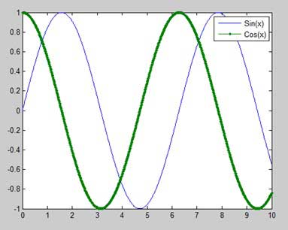
Plot3
It also possible to draw multiple graphs on the same point with simply the plot command
And add a legend to differentiate them like this
x = [0 : 0.01: 10];
y = sin(x);
g = cos(x);
plot(x, y, x, g, '.-'), legend('Sin(x)', 'Cos(x)')

Slide 12
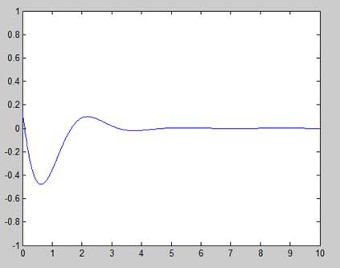
Plot4
It also possible to set the axis of a graph with the axis command
axis ( [xmin xmax ymin ymax] )
The example they show
x = [0 : 0.01: 10];
y = exp(-x).* sin(2*x + 3);
plot(x, y), axis([0 10 -1 1])
Results in

Slide 13
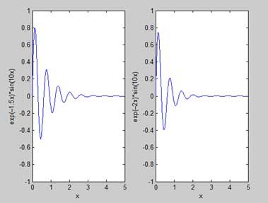
Plot5
The tutorial also show me how to make a subplot with subplot(m, n, p)
M and N are rows and columns and p is where the subplot will be located
So this example get us the result
x = [0:0.01:5];
y = exp(-1.5*x).*sin(10*x);
subplot(1,2,1)
plot(x,y), xlabel('x'),ylabel('exp(–1.5x)*sin(10x)'),axis([0 5 -1 1])
y = exp(-2*x).*sin(10*x);
subplot(1,2,2)
plot(x,y),xlabel('x'),ylabel('exp(–2x)*sin(10x)'),axis([0 5 -1 1])

Slide 14
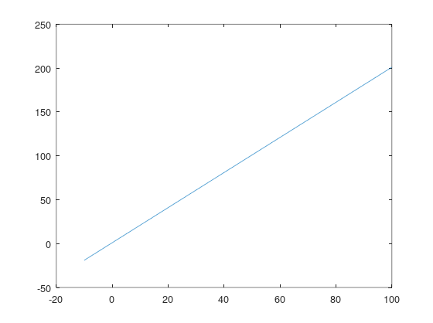
Plot,Salt,Smooth
For my program that would salt and smooth first I created 2 vectors for my x and y
x = -10:1:100
y = 2*x+1
Using plot(x,y) in the command window get you
Meaning this would be the original graph

Slide 15
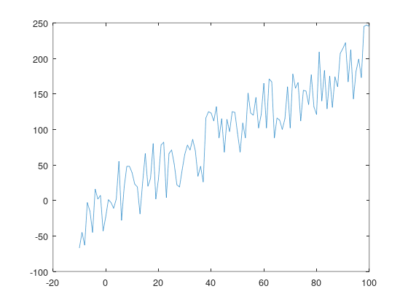
Plot,Salt,Smooth2
Next for my salter I used a simple for loop that would add the elements of y that been randomize into a second vector y2
for i = 1:length(y)
y2(i) = y(i)+randi(100)-50
endfor
Entering plot(x,y2) in the command window
get you this graph for salted

Slide 16
Plot,Salt,Smooth3
Finally the smoother was the most difficult part I ended up using a similar code to my program for this one but simpler since I didnt need to deal with a CSV now
for n = 1:length(y)
count1 = 0
count2 = 0
copy = n;
calc = 0
while(((copy-count1)>=1)&(count1<=3))
calc = calc + y(copy-count1)
count1 = count1+1
endwhile
while(((copy+count2)<length(y)-1)&(count2<3))
count2 = count2+1
calc = calc + y(copy+count2)
endwhile
calc = calc/(count1+count2)
y3(n) = calc
endfor

Slide 17
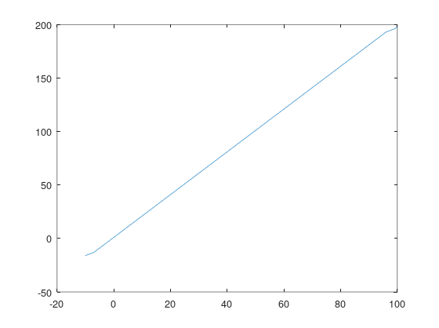
Plot,Salt,Smooth3
After that if you use the command
plot(x,y3) in the command window you get
This smoothed graph

